Slide 1
Discrete Mathematics
Dr. Han Huang
South China University of Technology

Slide 2
Chapter 5. Relations
n-ary Relations and Their Applications
Section 5.2

Slide 3
Contents
1
N-ary Relations and Databases
2
Operations on N-ary Relations
3
SQL

Slide 4
N-ary Relations and Databases

Slide 5
§5.2: n-ary Relations
An n-ary relation R on sets A₁,…,A_{n},
is a subset
R ⊆ A₁× … × A_{n}.
This is a straightforward generalisation of a binary relation. For example:

Slide 6
§5.2: n-ary Relations
An n-ary relation R on sets A₁,…,A_{n},
is a subset
R ⊆ A₁× … × A_{n}.
The sets A_{i} are called the domains of R.
The degree of R is n.
R is functional in the domain A_{i} if it contains at most one n-tuple (…, a_{i} ,…) for any value a_{i} within domain A_{i}.

Slide 7
§5.2: n-ary Relations
R is functional in the domain A_{i} if it contains at most one n-tuple (…, a_{i} ,…)
for any value a_{i} within domain A_{i}.
Generalisation: being functional in a combination of two or more domains.

Slide 8
Relational Databases
A relational database is essentially just a set of relations.
A domain A_{i} is a primary key for the database if the relation R is functional in A_{i}.
A composite key for the database is a set of domains {A_{i}, A_{j}, …} such that R contains at most 1 n-tuple (…,a_{i},…,a_{j},…) for each composite value
(a_{i}, a_{j},…)∈A_{i}×A_{j}×…
Notes:
This notation is a bit sloppy in that it suggests incorrectly that a composite key can consist of an infinite set of domains.
(This is to make things more readable.)

Slide 9
Example of Relational Data Model
(Student Name, ID Number, Major, GPA)
(Ackermann, 231455, Computer Science, 3.88)
(Adams, 888323, Physics, 3.45)
(Chou, 102147, Computer Science, 3.49)
(Rao, 678543, Mathematics, 3.90)
(Stevens, 786576, Psychology, 2.99)
Primary key is ID Number.

Slide 10
Operations on N-ary Relations

Slide 11
(Selection Operators)
Let A be any n-ary domain A=A₁×…×A_{n}, and let C:A→{T,F} be any condition (predicate) on elements (n-tuples) of A.
Then, the selection operator s_{C} is the operator that maps any n-ary relation R on A to the n-ary relation consisting of all
n-tuples from R that satisfy C. That is,
  s_{C}(R) = {a∈R | C(a) = T}

Slide 12
(Selection Operator Example)
Suppose we have a domain
A = StudentName × Standing × SocSecNos
Suppose we define a condition Upperlevel on A: UpperLevel(name,standing,ssn) :≡
[(standing = junior) ∨ (standing = senior)]
Then, s_{UpperLevel} is the selection operator that takes any relation R on A (database of students) and produces a relation consisting of just the upper-level students (juniors and seniors).

Slide 13
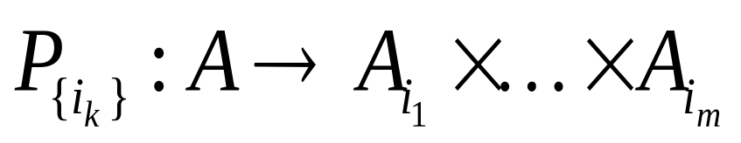
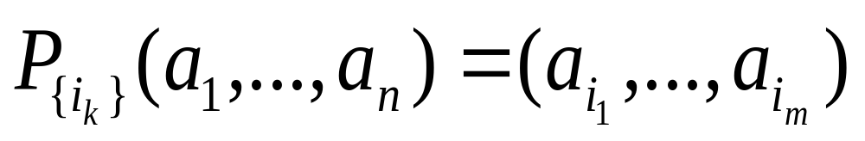
(Projection Operators)
Let A = A₁×…×A_{n} be any n-ary domain, and let {i_{k}}=(i₁,…,i_{m}) be a sequence of indices all falling in the range 1 to n,
  That is, 1 ≤ i_{k} ≤ n for all 1 ≤ k ≤ m.
Then the projection operator on n-tuples
is defined by:

Slide 14
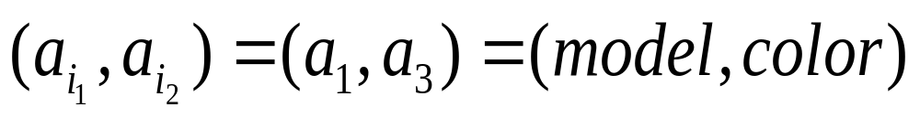
(Projection Example)
Suppose we have a ternary (3-ary) domain Cars=Model×Year×Color. (note n=3).
Consider the index sequence {i_{k}}= 1,3. (m=2)
Then the projection P maps each tuple
(a₁,a₂,a₃) = (model,year,color) to its image:
This operator can be usefully applied to a whole relation R⊆Cars (a database of cars) to obtain a list of the model/color combinations available.
{i_{k}}

Slide 15
(Join Operator)
Puts two relations together to form a combined relation which is their composition:
Iff the tuple (A,B) appears in R₁, and the tuple (B,C) appears in R₂, then the tuple (A,B,C) appears in the join J(R₁,R₂).
  A, B, and C can also be sequences of elements.

Slide 16
(Join Example)
Suppose R₁ is a teaching assignment table, relating Lecturers to Courses.
Suppose R₂ is a room assignment table relating Courses to Rooms,Times.
Then J(R₁,R₂) is like your class schedule, listing (lecturer,course,room,time).

Slide 17
SQL

Slide 18
Example of SQL
SELECT Departure_time FROM Flights
WHERE destination = ‘Detroit’
SELECT professor, time FROM teaching_assignments, class_schedule WHERE department = ‘mathematics’

Slide 19
Applications

Slide 20
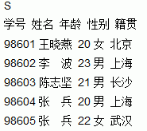
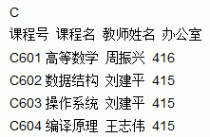
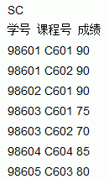
Applications
设有如下表所示的三个关系S、C和SC。用SQL语句表示:
(1)检索籍贯为福建的学生的姓名、学号和选修的课程号。
(2)检索选修了全部课程的学生姓名和年龄。

Slide 21
Applications
设有如下表所示的三个关系S、C和SC。用SQL语句表示:
(1)检索籍贯为福建的学生的姓名、学号和选修的课程号。
select 姓名,S.学号,课程号 from SC,S where 籍贯='福建' and S.学号=SC.学号
(2)检索选修了全部课程的学生姓名和年龄。
select 姓名,年龄 from S,C,SC where C.课程号=SC.课程号 and S.学号=SC.学号

Slide 22
End of Section 5.2
Click to edit company slogan .

